Slide 1
How to check blur existence in image?

Slide 2

Blur detection with opencv

Slide 3
Different solutions
1-Fast fourier transform
Extract the distribution of low and high frequencies
if there are a low amount of high frequencies, then the image can be considered blurry
Chllenge➔
However, defining what is a low number of high frequencies and what is a high number of high frequencies can be quite problematic, often leading to sub-par results.
2- using just basic grayscale pixel intensity statistics
3-more advanced and feature-based, evaluating the Local Binary Patterns of an image
FINALLY SOLUTION:
variation of the Laplacian

Slide 4
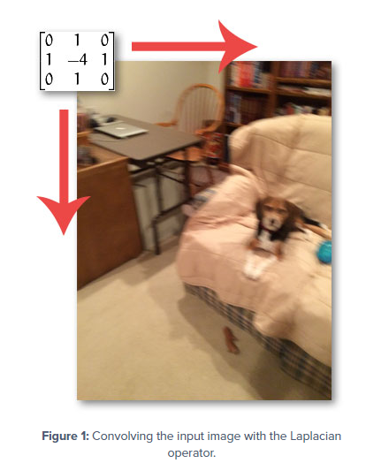
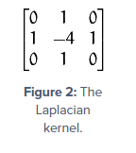
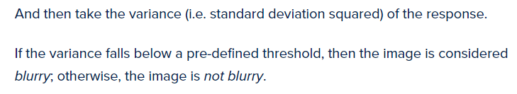
Variance of the Laplacian
DETECTING EDGES IN IMAGES
As we know, the more an image is blurred, the less edges there are.

Slide 5
Challenge of laplacian
Obviously the trick here is setting the correct threshold which can be quite domain dependent. Too low of a threshold and you’ll incorrectly mark images as blurry when they are not. Too high of a threshold then images that are actually blurry will not be marked as blurry. This method tends to work best in environments where you can compute an acceptable focus measure range and then detect outliers.

Slide 6
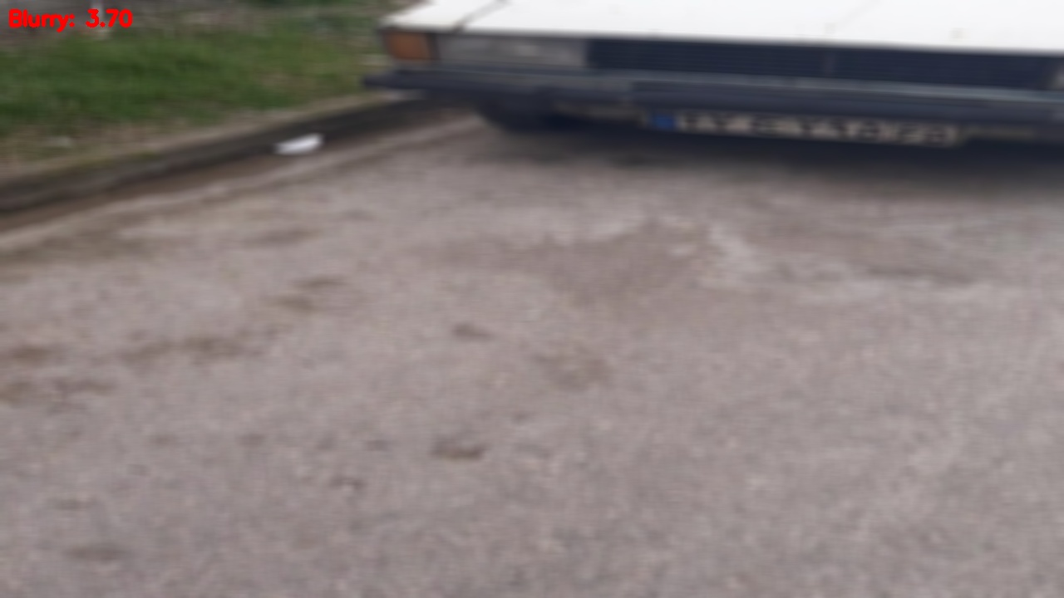
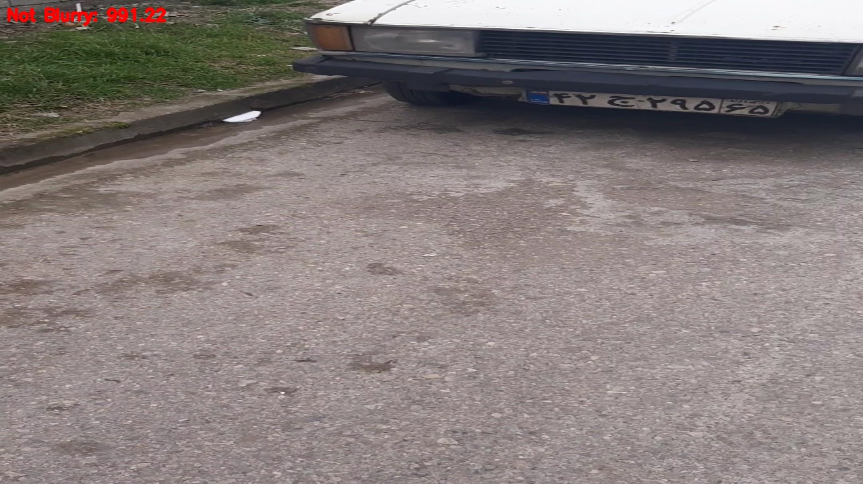
results
See my desktop

